Slide 1
A few met. highlights before
starting the new RUSSO™ session

Slide 2
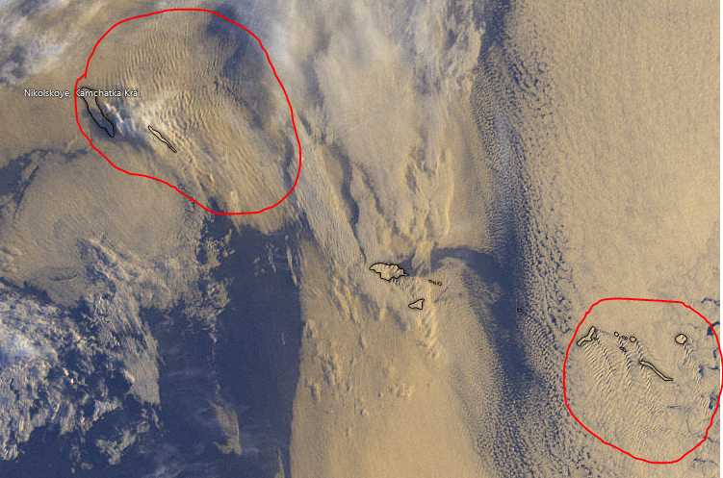
Trapped
Lee
Waves!

Slide 3
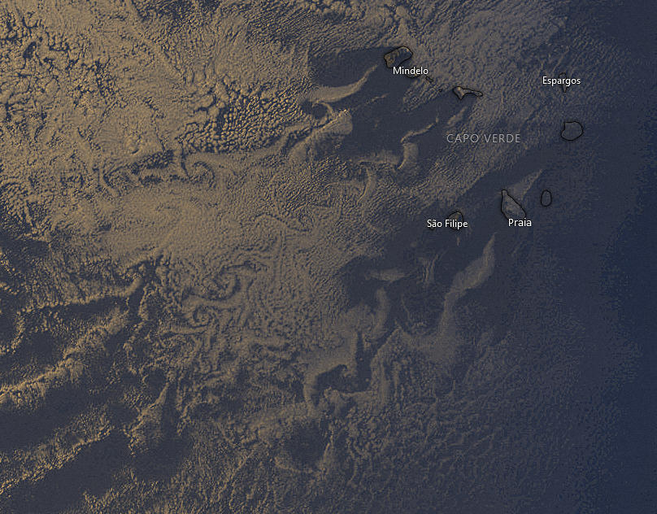
Lee vortices!
DON’T FALL IN THE TRAP:
They are not linked to any «boundary layer separation»

Slide 4
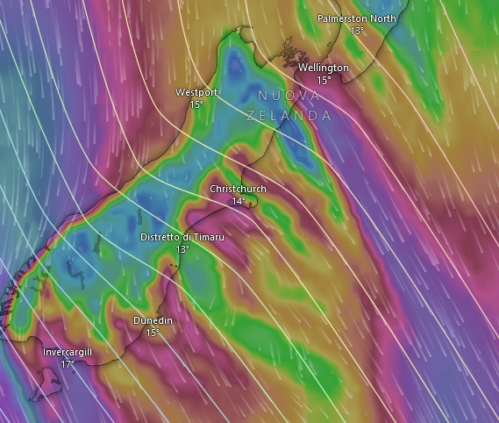
Gap flows!

Slide 5
… actual topic for today:
Reacting against Uniform SST cOnditions

Slide 6
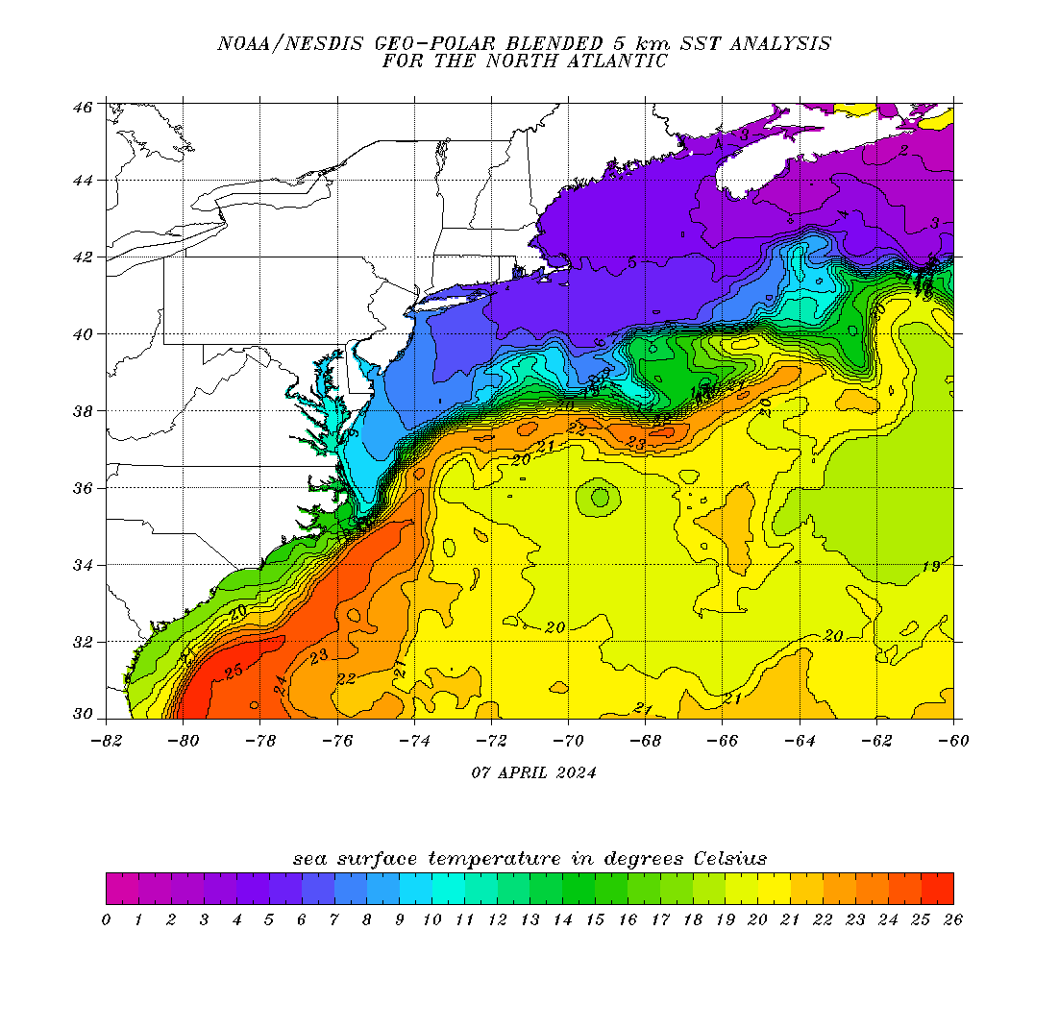
Brief summary on how the atmosphere responds to the strong SST gradients in the Gulf Stream
Notes:
https://eastcoast.coastwatch.noaa.gov/cw_geopolar_sst.php

Slide 7
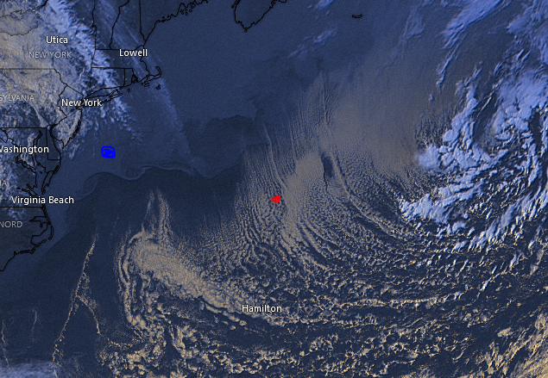
10
20

Slide 8
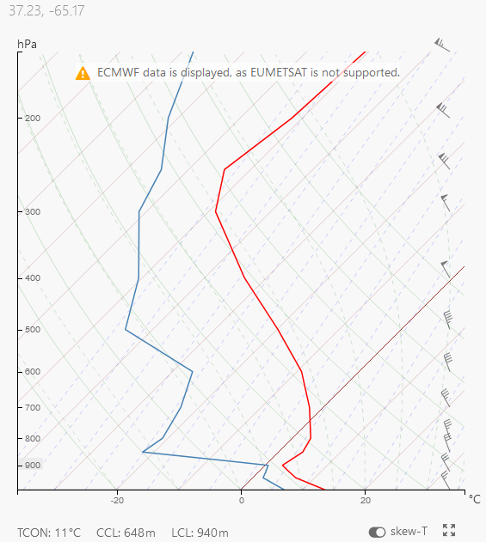
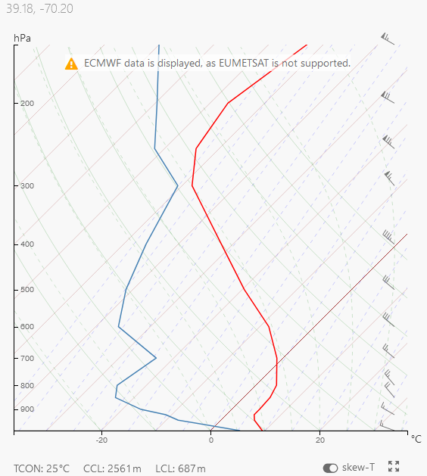
WARM
COLD

Slide 9
GS = strongest example of WBC
26 – 29 degC mxa temps
High seasonal variability
Strongest SST grads in winter as we will see
Notes:
-> Mechanisms unveiled here are valid for other structures (such as Kuroshio and Agulhas)

Slide 12
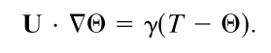
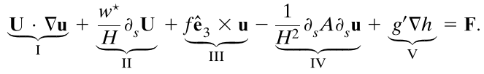
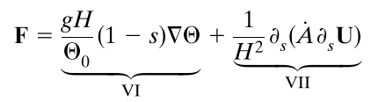

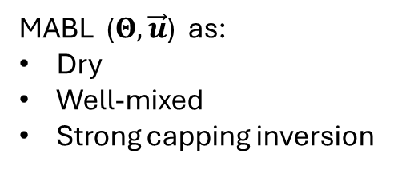
Schneider and Qiu 2015
Thermodynamics
balance between «buoyancy» and large-scale advection
MABL ($Θ, \vec{u}$) as:
Dry
Well-mixed
Strong capping inversion
Momentum
I + II + III + IV + V = quasi-stationary forcing terms… avoid too much detail Interestingly, instead, …
VI. modulation of hydrostatic pressure gradients (PA) VII. sensitivity to fluxes at the air-sea interface (DMM)
where $\dot{A}≡$ $\dot{A}$(SST) and usually $\dot{A}≡∂A/∂SST$
Notes:
SHOULD CHECK ABOUT VALIDITY: IS IT OK TO USE THESE EQUATIONS IN GS CONDITIONS?
I. SST-induced circulation advected by atmospheric mean wind II. vertical advection of LS vertical shear, H height of inversion III. Coriolis IV. divergence of vertical fluxes due to LS mixing V. hydrostatic adjustment of inversion height due to oceanic mesoscale
VI. modulation of hydrostatic pressure gradients (PA) VII. sensitivity to fluxes at the air-sea interface (DMM)

Slide 14
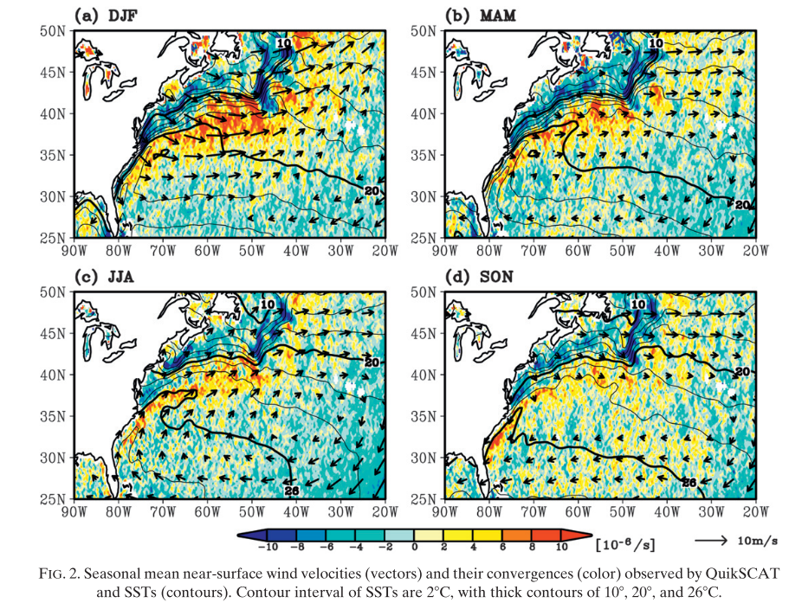
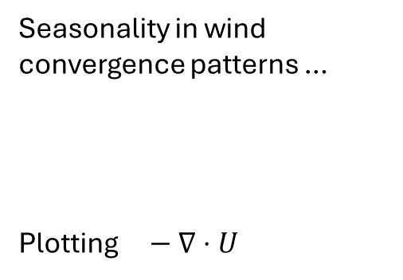
Seasonality in wind convergence patterns …
Plotting $− ∇⋅U$
Minobe et al. 2010

Slide 15
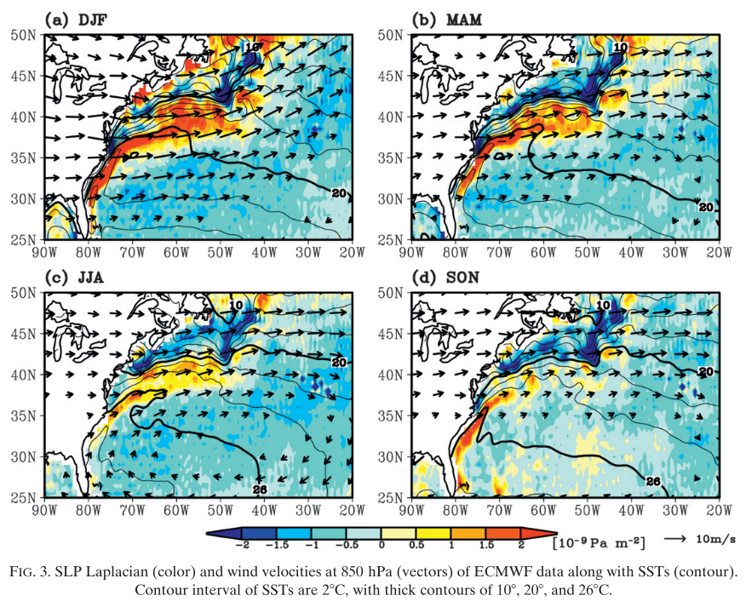
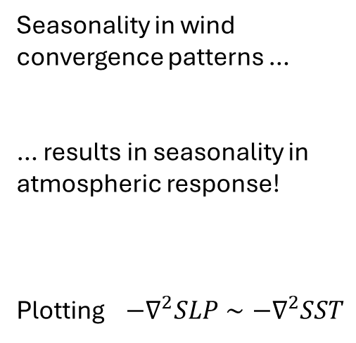
Seasonality in wind convergence patterns …
… results in seasonality in atmospheric response!
Plotting $−∇^{2}SLP∼−∇^{2}SST$
Minobe et al. 2010

Slide 16
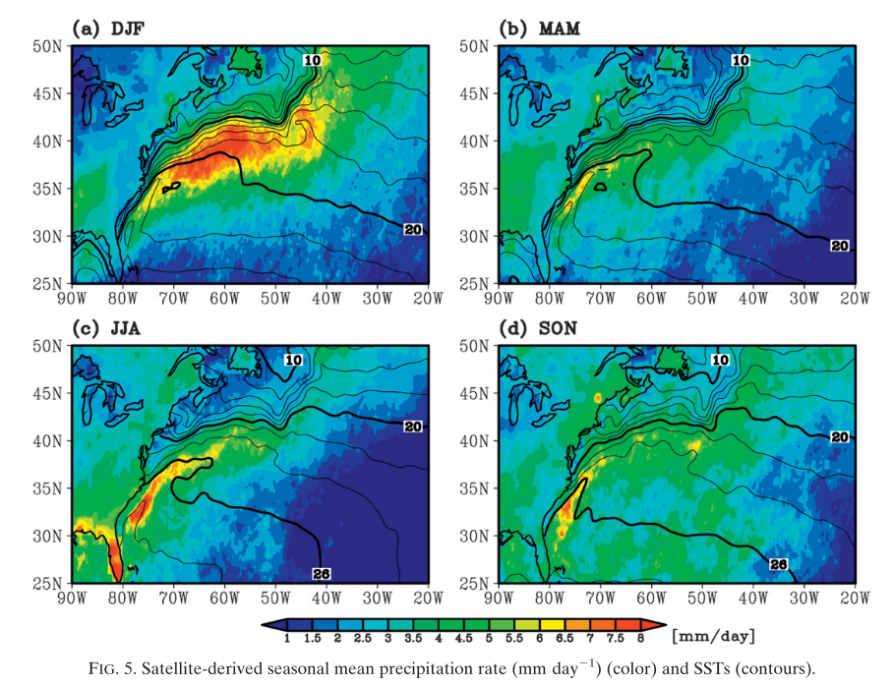
Seasonality in wind convergence patterns …
… results in seasonality in atmospheric response!
… with clear consequences on

